Slide 1
COVID-19 & Public Policy
Team 5
Beth Green, Himanshu Sharma, Joey Clancy, Supriya Prasad, Weihang He
Notes:
Image: https://covid19.who.int/

Slide 2
Dataset Overview
Number of Rows
75,773
Number of Columns
41
Time Span
2 January, 2020 to 31 December, 2020
Number of Countries
196

Slide 3
Dataset Overview
The dataset contains daily information for each country pertaining to:
Demography – population, age, urban/rural
Pandemic – Infection rates, cases, mortality
Policy – special measures/mandates enforced by policymakers
Medical infrastructure – Beds per capita, medical professionals
Weather – Temperature, humidity, wind
Electricity Grid
Aviation
For this project – focus on policy changes and their corresponding effect on number of active cases

Slide 4
Categories of Policy Change
School
Work
Events
Gatherings
Transportation
AtHome
National
International
Information
Testing
Tracing
AtHome
0 - no measures
1 - recommend not leaving house
2 - require not leaving house with exceptions for daily exercise, grocery shopping, and 'essential' trips
3 - require not leaving house with minimal exceptions

Slide 5
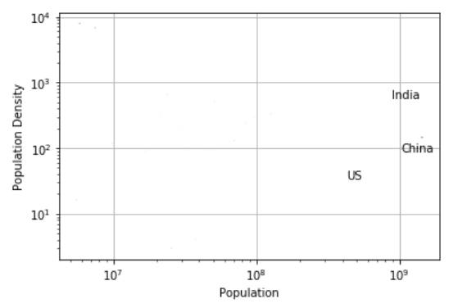
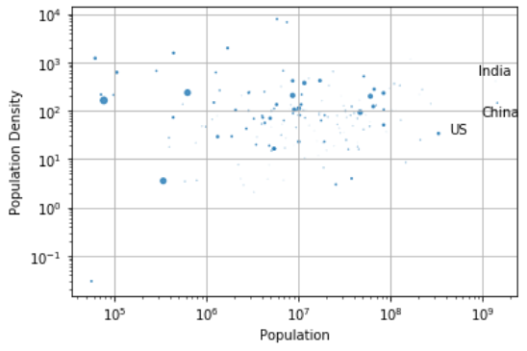
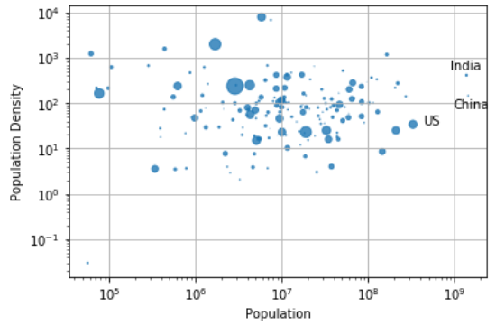
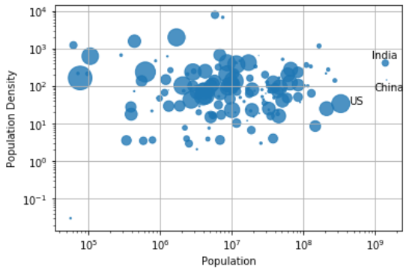
Change in Infection Rates over Time
February 1, 2020
March 31, 2020
June 30, 2020
December 31, 2020

Slide 6
Incentive and Project Goal
82.95 million cases
1.87 million deaths
Evaluate the impact of the pandemic over the policy and vice versa
Compare the strategies different countries took in the early stages
The total number of confirmed cases worldwide by the end of 2020
Our data:
COVID-19 Political Measures and Weather Impact: COVID19 Political Measures & Weather Impact | Kaggle
Notes:
https://ourworldindata.org/coronavirus-data

Slide 7
Hierarchical Clustering
Objective: group countries by policy level
Uses:
Creating groups to enable further, more specific analysis
Understand a country's policy journey and changes

Slide 8
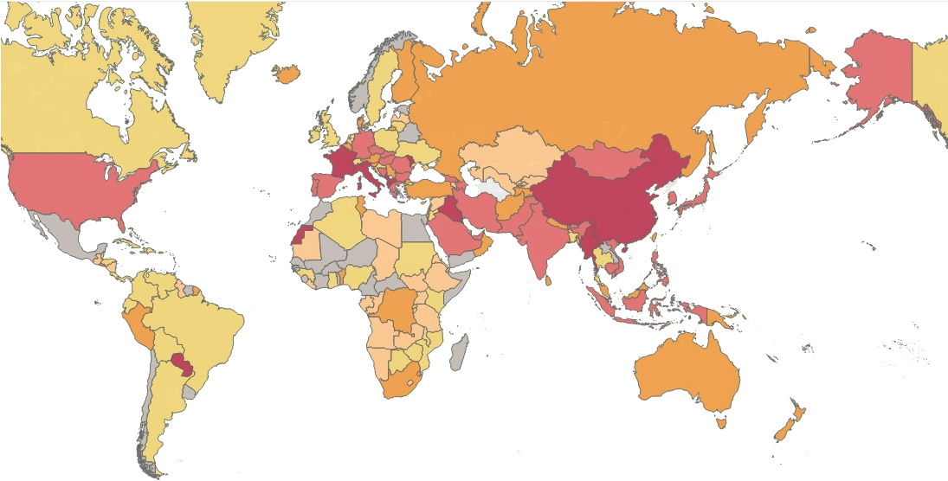
3/11/2020 Clusters
1: Little to no policies in place
6: Public information campaigns are becoming coordinated
3: International travel quarantines and public officials urge caution
2: International travel controls with moderate testing and tracing policies
5: School closures plus international travel controls and moderate testing and tracing policies
4: Lockdown

Slide 9
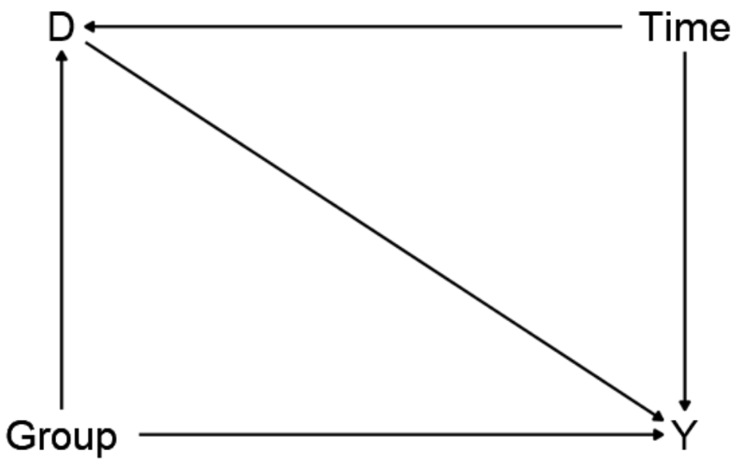
Difference in Differences Method
What is it?
How does it work?
Assumptions and issues associated with our models
Notes:
What is it?
- Basic idea is to look at the effect of a policy(s) on a treated group.
- In our case, we want to know the effect of the enactment of policies on the effective reproduction number in three countries, the US, China, and India.
How does it work?
***(click)***
Causal diagram
- D: Treatment/policies
- Y: Outcome variable or REFF
- Time -> Y: All other variables and factors (backdoors) that change over time that could impact the outcome variable (beside treatment)
- Time -> D: Because the treatment went into effect at a certain time, time and treatment are changing at the same place and are completely intertwined. Hence, there being a backdoor from treatment to time back to the outcome variable.
- Can't control for time, because removing variation due to time removes the variation of before/after effects leaving us with no effect at all.
- Group: Need control group, because if variation due to time is removed, there is no leftover effect for the group. To fix this we add a control group and assume that treatment/time affects both groups differently.
Assumptions/Issues
- Policies stay active (not true but necessary for creation of control groups)
- The effects of the various levels within a policy category are negligible.
- Treatment consists of the enactment of policies across all categories at some level above zero.

Slide 10
DiD Results – United States
United States
First instance of treatment occurs on March 19th, 2020
Group | After Treatment | Average R_{eff}
Untreated | No | 0.350
Untreated | Yes | 1.05
Treated | No | 1.09
Treated | Yes | 0.987
Before-After Treated Group | -0.099
Before-After Untreated Group | 0.696
Treatment Effect | -0.795***

Slide 11
DiD Results – China
China
First instance of treatment occurs on February 25th, 2020
Group | After Treatment | Average R_{eff}
Untreated | No | 0.117
Untreated | Yes | 1.04
Treated | No | 0.666
Treated | Yes | 0.996
Before-After Treated Group | 0.330
Before-After Untreated Group | 0.920
Treatment Effect | -0.590***

Slide 12
DiD Results – India
India
First instance of treatment occurs on March 20th, 2020
Group | After Treatment | Average R_{eff}
Untreated | No | 0.368
Untreated | Yes | 1.04
Treated | No | 1.07
Treated | Yes | 0.988
Before-After Treated Group | -0.084
Before-After Untreated Group | 0.676
Treatment Effect | -0.761***

Slide 13
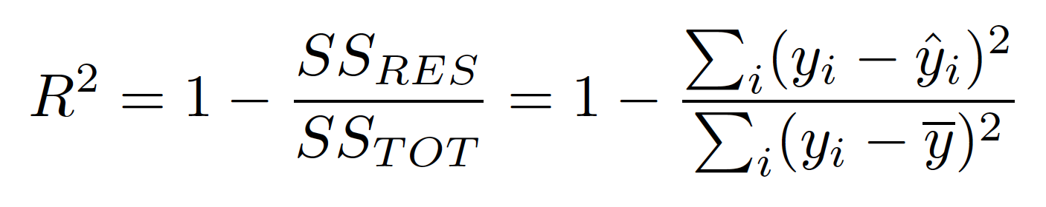
Regression – New Cases
Goal:
Can we predict the number of daily new cases in India, China and US?
Business Value:
ML models can help the government evaluate the impact of policy changes (along with other variables) by predicting daily “New Cases”.
ML algorithms used:
Decision Tree
Random Forest
Gradient Boosting
Metric used:
Out of sample R2
Notes:
Steps to Gradient Boosting:
1. Fit a simple linear regressor or decision tree on data [call x as input and y as output]
2. Calculate error residuals. Actual target value, minus predicted target value [e1= y - y_predicted1 ]
3. Fit a new model on error residuals as target variable with same input variables [call it e1_predicted]
4. Add the predicted residuals to the previous predictions [y_predicted2 = y_predicted1 + e1_predicted]
5. Fit another model on residuals that is still left. i.e. [e2 = y - y_predicted2] and repeat steps 2 to 5 until it starts overfitting or the sum of residuals become constant. Overfitting can be controlled by consistently checking accuracy on validation data.

Slide 14
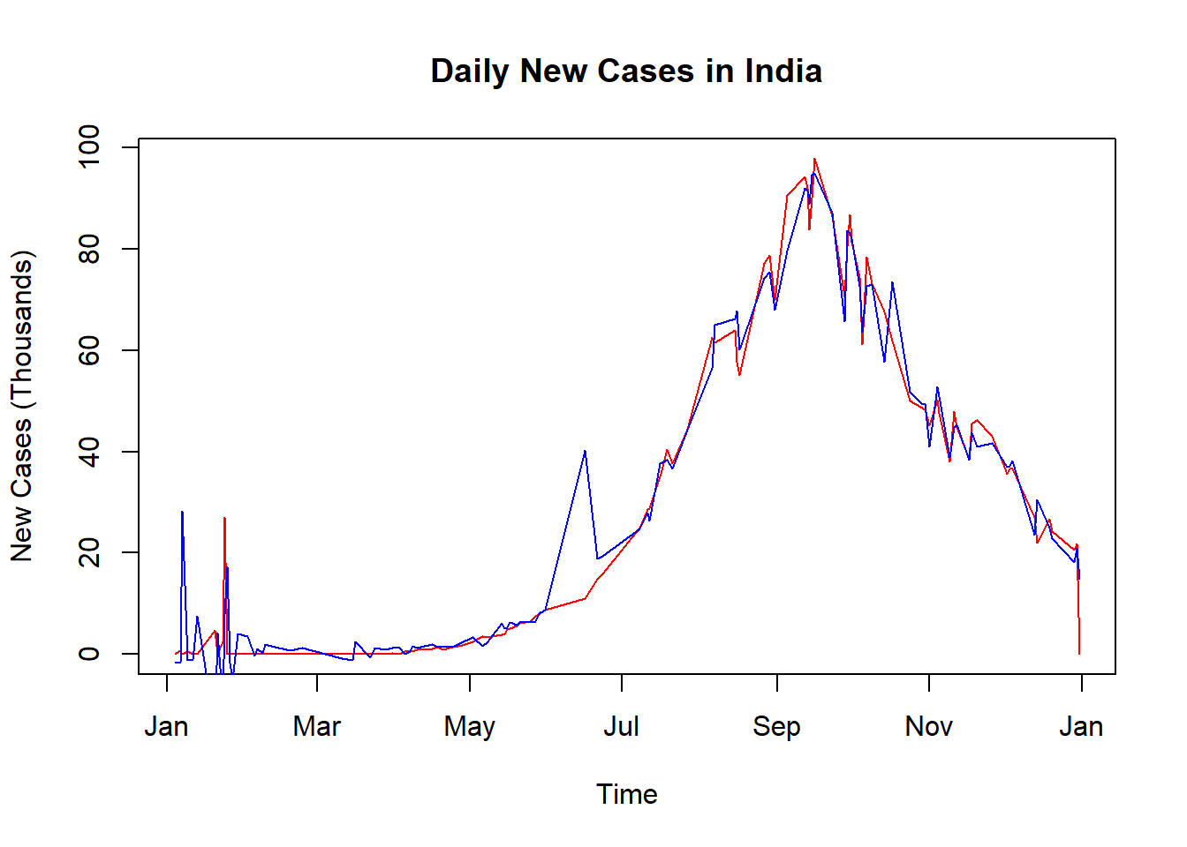
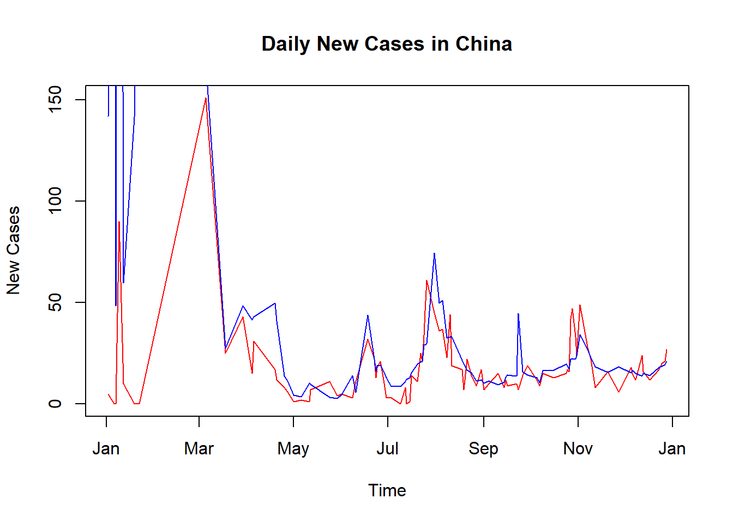
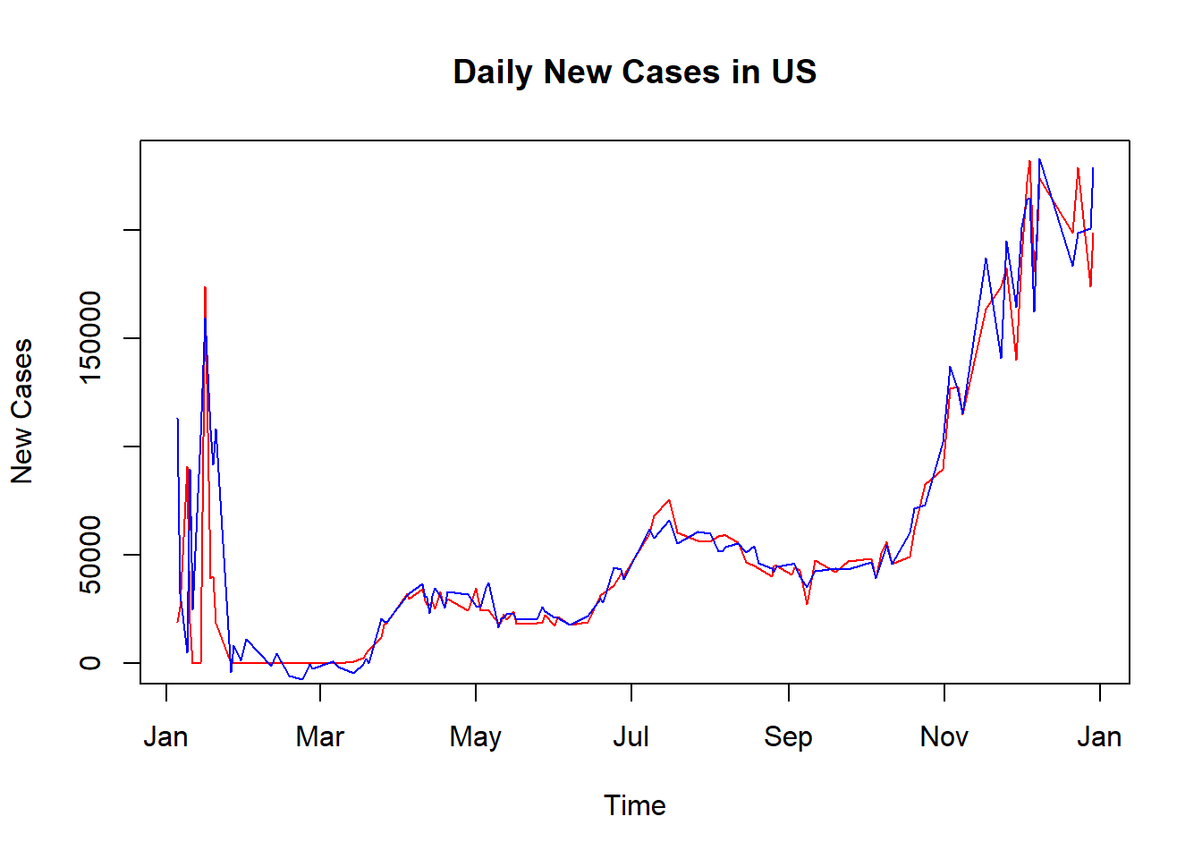
Regression – New Cases
India
Algorithm | OOS R2
Decision Tree | 0.929
Gradient Boosting | 0.96
China
Algorithm | OOS R2
Decision Tree | -1.48
Random Forest | 0.83
US
Algorithm | OOS R2
Decision Tree | 0.794
Gradient Boosting | 0.859
If China decides to be lenient from Jan 1st, 2021, then the RF model predicts daily new cases will rise to 93 from the previous week average of ~24.

Slide 15
Our Research
Obstacles
Data cleaning
Work with a large dataset
269.74 million cases
5.30 million deaths
The total number of confirmed cases worldwide by Dec.2021
Lessons learned
Public policies have been effective in the face of the COVID-19 pandemic
What should be done now?
Notes:
Original dataset vs. Edited dataset
How to determine an actionable topic

Slide 16
Thank You

Slide 17
Appendix

Slide 18
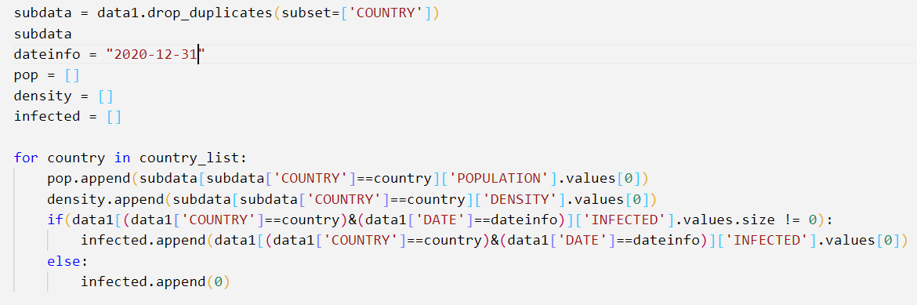
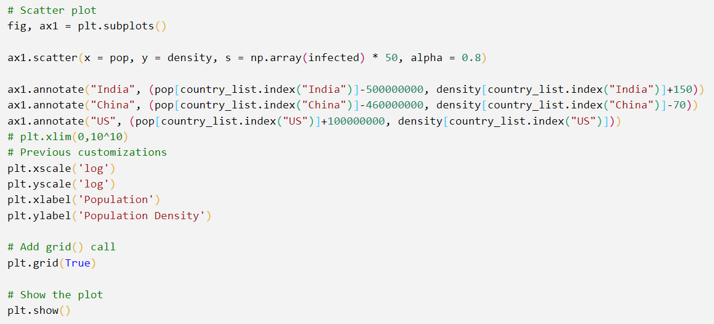
Scatter plot - Code
Date

Slide 19
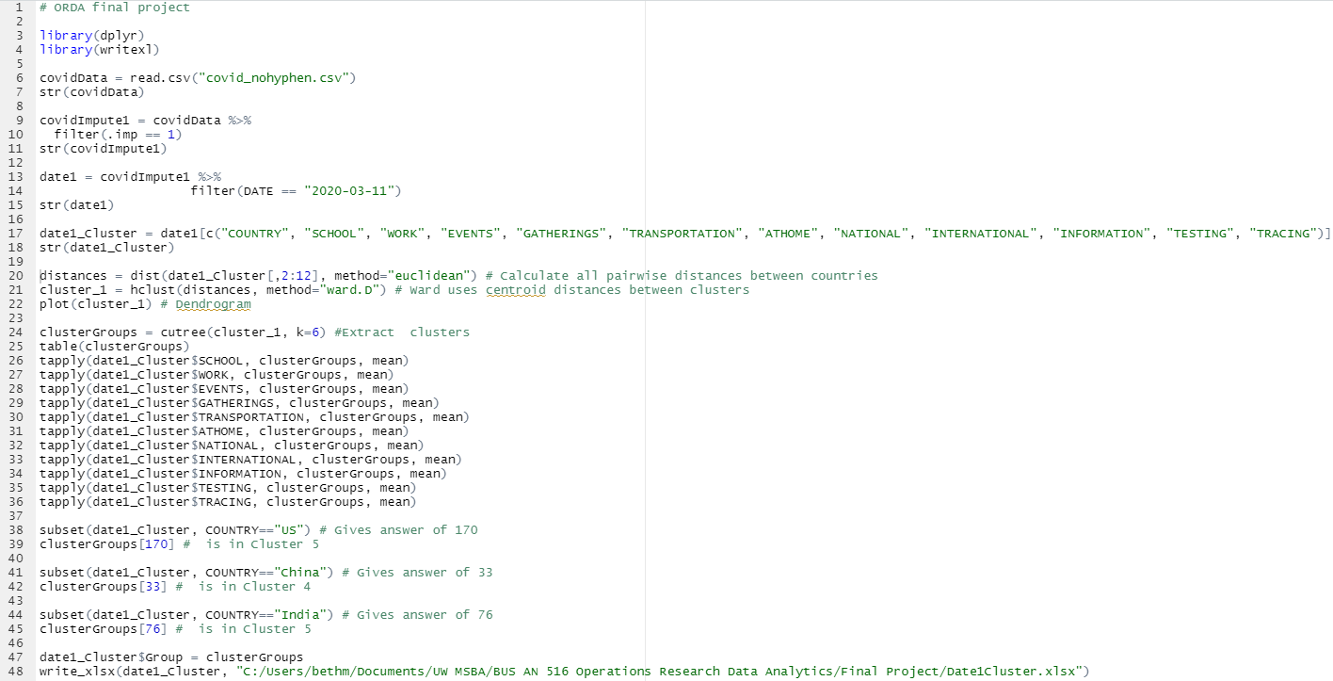
Clustering - Code

Slide 20
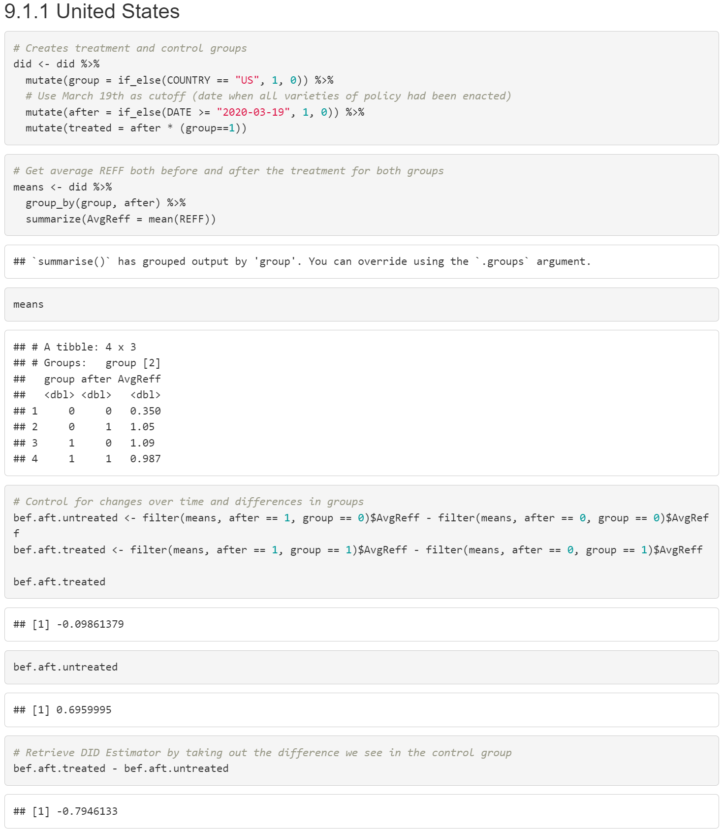
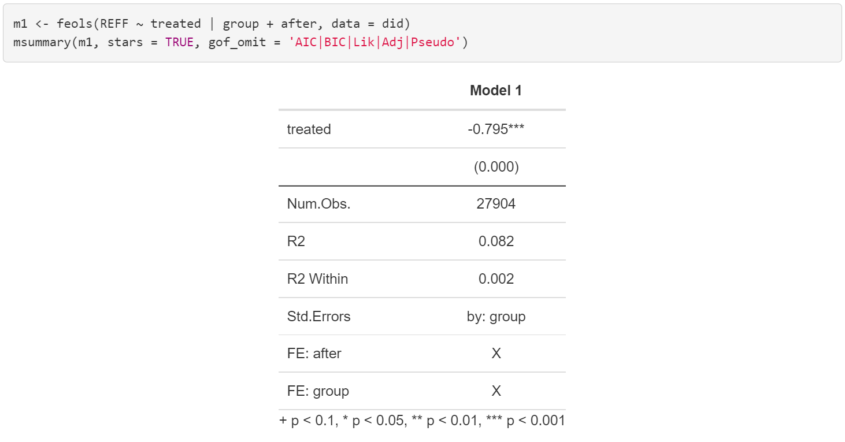
DiD - Code
Country
Date
In order to repeat the process for China and India, simply change the binary group indicator to the respective country and change the effective treatment date (top left).

Slide 21
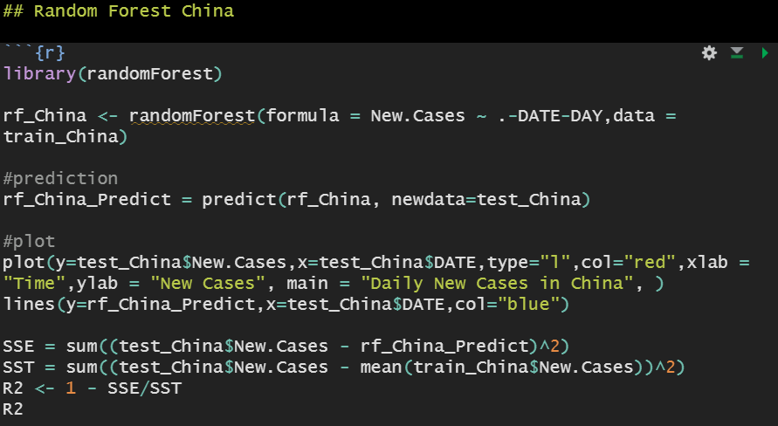
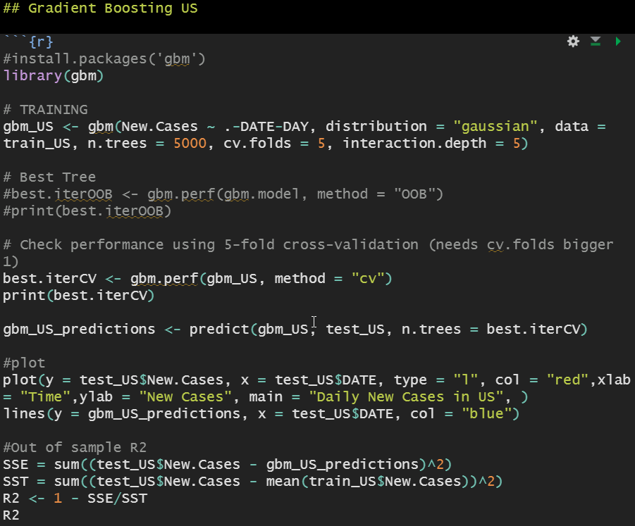
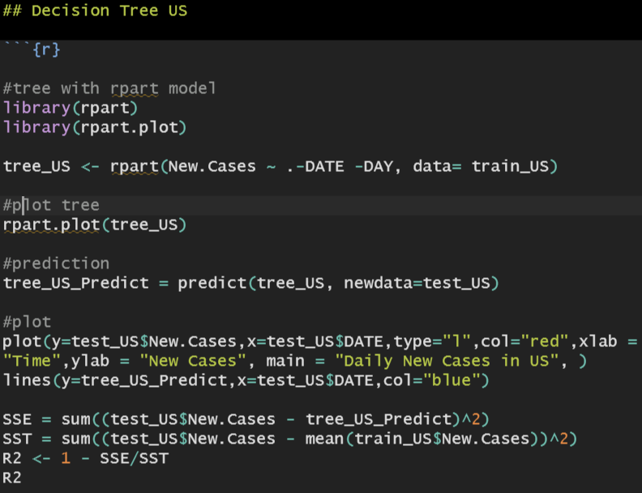
Regression - Code

